Slide 2
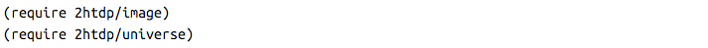
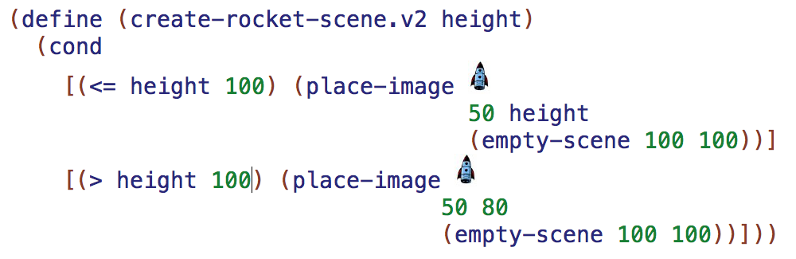
Warm Up
Circle all of the values that are used repeatedly.

Slide 3
create-rocket-scene version 3 takes in height
But that isn't really what is happening

Slide 4
create-rocket-scene should really take in time because the clock is what produces the animation

Slide 5
Instead of giving time directly to create-rocket-scene we should pass the time to the distance function

Slide 6
Now the height of the rocket can be computed by a proper distance function and we can add gravity and initial velocity.

Slide 7

distance
In physics class you were given the following reference equation

Slide 8
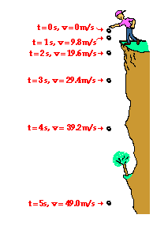
distance changes with respect to time

Slide 9

distance as a function of time
Equations
are more clearly expressed as
functions

Slide 10
programs don’t need to abbreviate
(define (distance time)
(+ (* INITIAL-VELOCITY time)
(* 1/2 ACCELERATION (sqr time))))

Slide 11
programs don’t need to abbreviate
function name
parameter
(define (distance time)
(+ (* INITIAL-VELOCITY time)
(* 1/2 ACCELERATION (sqr time))))

Slide 12
programs don’t need to abbreviate
function body
(define (distance time)
(+ (* INITIAL-VELOCITY time)
(* 1/2 ACCELERATION (sqr time))))

Slide 13
programs don’t need to abbreviate
body expression
(define (distance time)
(+ (* INITIAL-VELOCITY time)
(* 1/2 ACCELERATION (sqr time))))

Slide 14
programs don’t need to abbreviate
body expression
(define (distance time)
(+ (* INITIAL-VELOCITY time)
(* 1/2 ACCELERATION (sqr time))))

Slide 15
programs don’t need to abbreviate
body expression
(define (distance time)
(+ (* INITIAL-VELOCITY time)
(* 1/2 ACCELERATION (sqr time))))

Slide 16
Agenda
Design a program to land a UFO on the ground.
Novice - A UFO should descend from the top of the scene to the bottom. It should land on its feet, dropping from the top of the scene to the bottom, and cannot go past the bottom of the scene. The size of the scene should be controlled by one value.
Apprentice - Refactor the definition of the function to use only one place-image expression in the body of the function.
Practitioner - Add a distance function to the program using the equations you have learned in physics class. The function should be defined as
d(t) = v_i*t + 1/2 * a * t^2. Call the function in the body of create-rocket-scene to control the descent of the rocket.
Professional - Add a status line that says "descending" when the UFO’s height is above one third of the height of the canvas. It switches to "closing in" below that. And finally, when the UFO has reached the bottom of the canvas, the status notifies the player that the UFO has "landed."

